Slide 1

Disruption to Test Scores after Tropical Cyclones in the United States
Art by Amy Wolfe
Gabriella Y Meltzer, Joan A Casey, Joel Schwartz, Michelle L Bell, G Brooke Anderson, Marianthi-Anna Kioumourtzoglou, Robbie M Parks
June 21, 2023
Email: gm3085@cumc.columbia.edu
Twitter: @gabriellameltz

Slide 2

What is a tropical cyclone?
2
Notes:
Time (1 min)
CLICK then leave!
Tropical cyclones, such as hurricanes and tropical storms (such as Henri right now), as you can see an example of here, are intense circular storms that originate over warm tropical oceans and are characterized by low atmospheric pressure, and high wind speeds
They draw energy from the sea surface and maintain strength as long as they remain over warm water
When they make landfall it can be extremely disruptive and very destructive
Several hurricane-force tropical cyclones live long in the memory of many people in the United States
Why should we care about them in relation to health?
CLICK

Slide 3
US educational system
3
Notes:
Robbie: Standardized testing
SEDAC info? https://exhibits.stanford.edu/data/catalog/db586ns4974

Slide 4





Why should we care about tropical cyclones?
Very active in US
2020 season most active on record
2021: 3rd time on record names exhausted
Will remain a threat in US
Longer landfall and peak closer to land
Extremely costly
Over $2 trillion in damage
Evidence of serious educational consequences
Hurricane Katrina displaced 100k-200k students
Destroyed 78% of New Orleans public school buildings
Cyclones are a deadly threat in many vulnerable parts of the world
Knowledge of US impacts helps worldwide efforts
Resilience is a matter of environmental justice
Impact low-income and historically disadvantaged communities
Normalized US hurricane damage from 1900 to 2017.
Landward migration of global tropical cyclone activity.
NOAA
Wang and Toumi, Science, 2021
NASA
Weinkle et al., Nature Sustainability, 2018
NOAA
4
Huffington Post

Slide 5
Disruption to Test Scores after Tropical Cyclones in the United States
Art by Amy Wolfe
Hurricanes and other tropical cyclones have devastating effects on society
A comprehensive assessment of their impacts on educational attainment over multiple years of study is lacking, despite plausible links
5
Meltzer et al., In preparation (please do not share or distribute)

Slide 6
Aims
Examine the association between tropical cyclones and educational attainment among elementary- and middle school-age students in all affected areas in the United States
Evaluate how the effects vary by strength of tropical cyclone and by sociodemographic composition of the student bodies and communities affected
6
Meltzer et al., In preparation (please do not share or distribute)

Slide 7
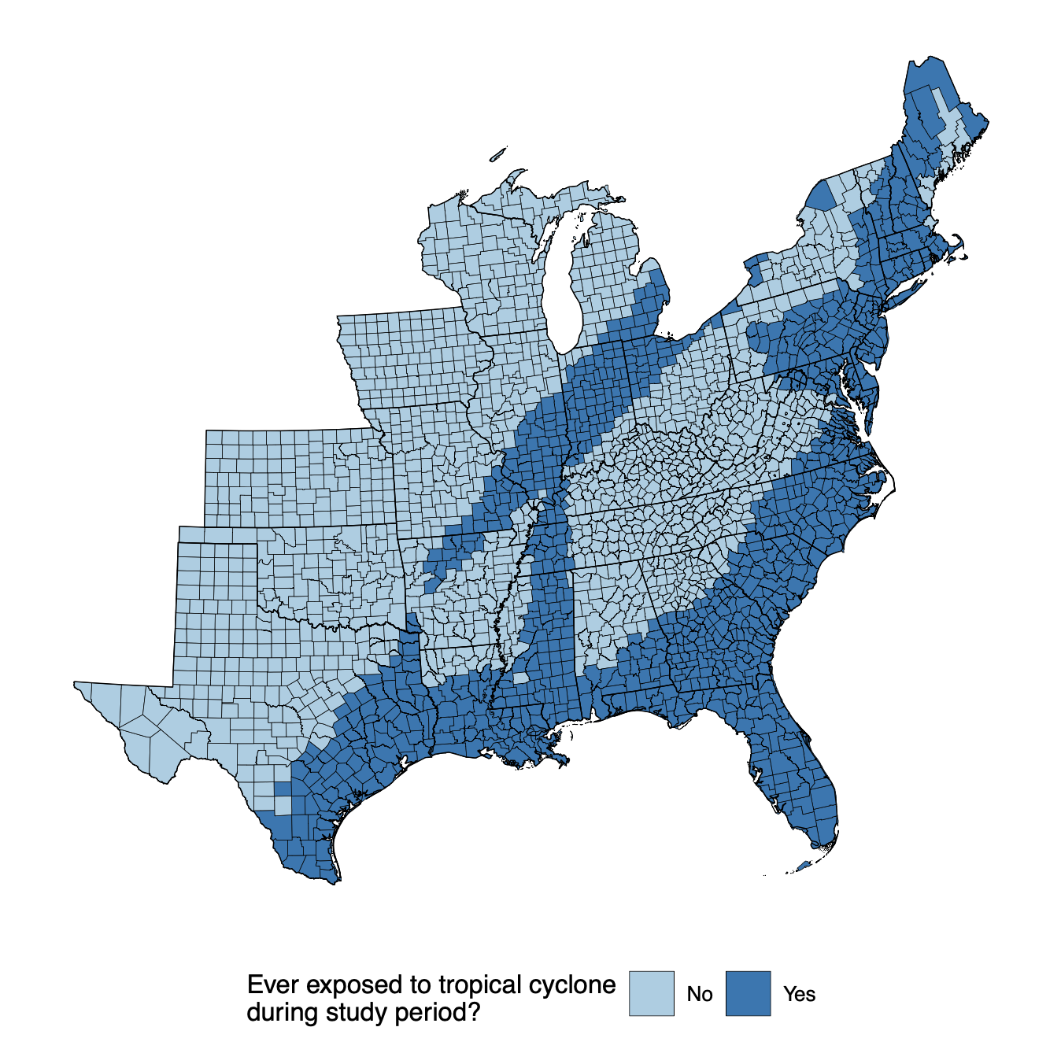
Study population, outcome and exposure assessment
Study population
Third to eighth grade students from 2009-2018 in 2,420 counties in contiguous US
Outcome assessment
County-level average standardized test scores in math and reading/language arts (RLA)
Stanford Educational Data Archive
Exposure assessment
Tropical cyclone exposure
Counties with sustained maximal wind speeds
Tropical cyclones: ⩾ 34 knots
Hurricanes: ⩾ 64 knots
7
Meltzer et al., In preparation (please do not share or distribute)

Slide 8
Statistical model
Association between average Math and RLA and tropical cyclone exposure:
Bayesian formulation of difference-in-differences model
To quantify association:
Associations modeled by tropical cyclones and hurricanes
Associations modeled nationally and by state
Effect modification by county and grade cohort level characteristics
Adjusted for time-varying grade-cohort and county-level covariates:
Grade-cohort: race/ethnicity, economic disadvantage, free/reduced lunch, ESL learners
County: college degree, poverty, household income, urbanicity, SNAP recipients, single mother households
County poverty tertiles
8
Meltzer et al., In preparation (please do not share or distribute)

Slide 9
Results: National model
Full regression results of county-level standardized test scores on hurricane exposure and covariates
 | Math: β (95% CrI) | RLA: β (95% CrI)
Tropical cyclone exposure | 0.00 (-0.05, 0.05) | 0.01 (-0.04, 0.05)
Native American | -1.13 (-1.95, -0.31) | -1.64 (-2.35, -0.94)
Hispanic/Latino | -0.97 (-1.13, -0.80) | -1.63 (-1.77, -1.49)
Black | -1.99 (-2.16, -1.83) | -2.25 (-2.40, -2.10)
Free-lunch eligible | -0.31 (-0.39, -0.24) | 0.14 (0.08, 0.20)
Reduced-price lunch eligible | -0.20 (-0.47, 0.07) | 0.47 (0.24, 0.69)
Economically disadvantaged | -0.04 (-0.11, 0.03) | -0.60 (-0.66, -0.54)
English language learner | 0.59 (0.12, 1.06) | -1.13 (-1.52, -0.75)
Urban | 0.12 (-0.03, 0.27) | 0.21 (0.08, 0.33)
Log of median income | 0.07 (-0.04, 0.18) | 0.01 (-0.08, 0.10)
Bachelor's degree rate | 2.01 (1.67, 2.35) | 1.79 (1.51, 2.08)
Poverty rate | -0.75 (-1.07, -0.43) | -0.05 (-0.31, 0.21)
SNAP receipt rate | -0.22 (-0.50, 0.06) | 0.19 (-0.04, 0.43)
Single-mom household rate | 0.08 (-0.23, 0.38) | 0.05 (-0.21, 0.30)
9
Meltzer et al., In preparation (please do not share or distribute)

Slide 10
Results: State-specific model
Regression of county-level standardized test scores on hurricane exposure and covariates, state-specific results
 | Math: β (95% CrI) | RLA: β (95% CrI)
Overall | 0.00 (-0.05, 0.05) | 0.00 (-0.04, 0.05)
Alabama (1) | 0.13 (-0.04, 0.32) | 0.04 (-0.08, 0.17)
Florida (12) | 0.19 (0.11, 0.27) | 0.07 (0.00, 0.13)
Georgia (13) | -0.07 (-0.17, 0.03) | 0.00 (-0.08, 0.08)
Louisiana (22) | -0.02 (-0.26, 0.21) | 0.00 (-0.16, 0.16)
New Jersey (34) | -0.12 (-0.34, 0.06) | -0.03 (-0.17, 0.10)
North Carolina (37) | -0.15 (-0.26, -0.04) | 0.04 (-0.05, 0.13)
South Carolina (45) | -0.19 (-0.42, 0.06) | 0.02 (-0.12, 0.15)
Texas (48) | -0.10 (-0.21, 0.01) | -0.13 (-0.21, -0.05)
Note: LL = lower limit, UL = upper limit
10
Meltzer et al., In preparation (please do not share or distribute)

Slide 11
Results: Effect modification by cohort race/ethnicity
Effect measure modification by grade cohort race/ethnicityª: hurricane coefficient/interaction term coefficients
 | Math: β (95% CrI) | RLA: β (95% CrI)
Tertile 1 | 0.00 (reference) | 0.00 (reference)
Tertile 2 | -0.06 (-0.46, 0.35) | -0.10 (-0.45, 0.26)
Tertile 3 | -0.01 (-0.41, 0.39) | -0.04 (-0.39, 0.31)
a) Percentage of Black, Hispanic/Latinx, and Native American students
11
Meltzer et al., In preparation (please do not share or distribute)
Notes:
Robbie: please make this slide match positions and size of next slide

Slide 12
Results: Effect modification by county poverty rate
Effect measure modification by county poverty rate: hurricane coefficient/interaction term coefficients
 | Math: β (95% CrI) | RLA: β (95% CrI)
Tertile 1 | 0.00 (reference) | 0.00 (reference)
Tertile 2 | -0.09 (-0.20, 0.02) | -0.12 (-0.21, -0.03)
Tertile 3 | -0.08 (-0.20, 0.03) | -0.04 (-0.14, 0.06)
12
Meltzer et al., In preparation (please do not share or distribute)

Slide 13
Summary
Negative association between hurricanes and standardized test scores only observed in some states
North Carolina (math)
Texas (RLA)
Florida (positive)
Certain groups at greater risk of lapses in educational attainment
Native American, Black, Hispanic/Latinx
Low socioeconomic status
English language learners (RLA)
Next steps
Evaluate all tropical cyclones in addition to hurricanes
Analyze lagged effects of fall hurricane season on following spring testing
13
Meltzer et al., In preparation (please do not share or distribute)

Slide 14



Co-authors, collaborators, and funding
University of Washington
Joan Casey
Columbia University
Gabriella Y Melzter, Marianthi-Anna Kioumourtzoglou, Robbie M Parks
Harvard University
Joel Schwartz
Yale University
Michelle L Bell
Colorado State University
G Brooke Anderson
Supported by:
5T32ES007322-21
R00ES033742
14
Meltzer et al., In preparation (please do not share or distribute)

Slide 15
Disruption to Test Scores after Tropical Cyclones in the United States
Art by Amy Wolfe
Gabriella Y Meltzer, Joan A Casey, Joel Schwartz, Michelle L Bell, G Brooke Anderson, Marianthi-Anna Kioumourtzoglou, Robbie M Parks
June 21, 2023
Email: gm3085@cumc.columbia.edu
Twitter: @gabriellameltz

